Slide 1
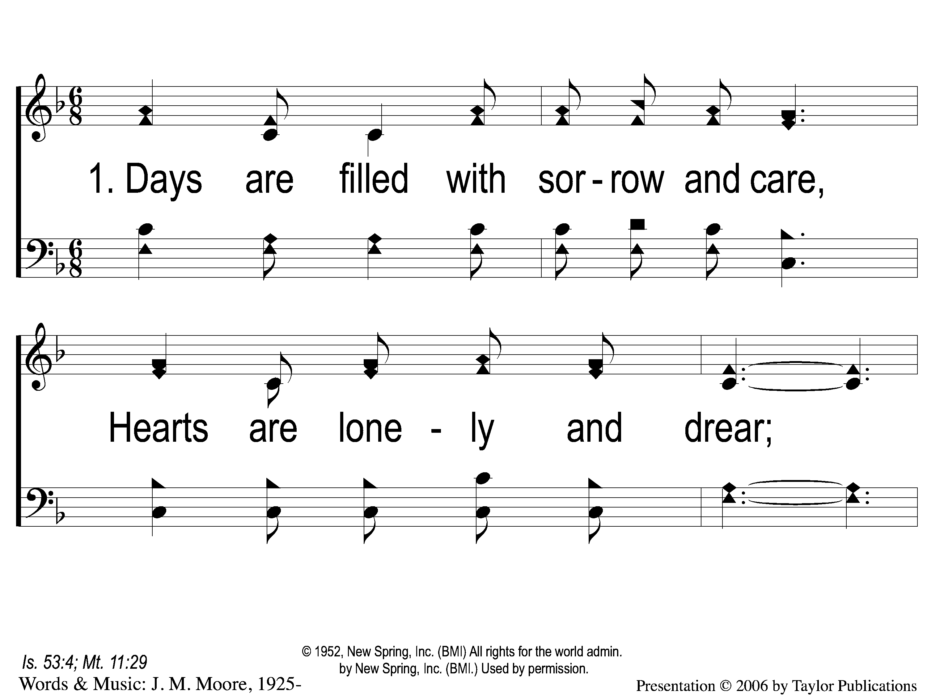
1-1 Burdens Are Lifted At Calvary
Burdens Are Lifted At Calvary
50

Slide 2
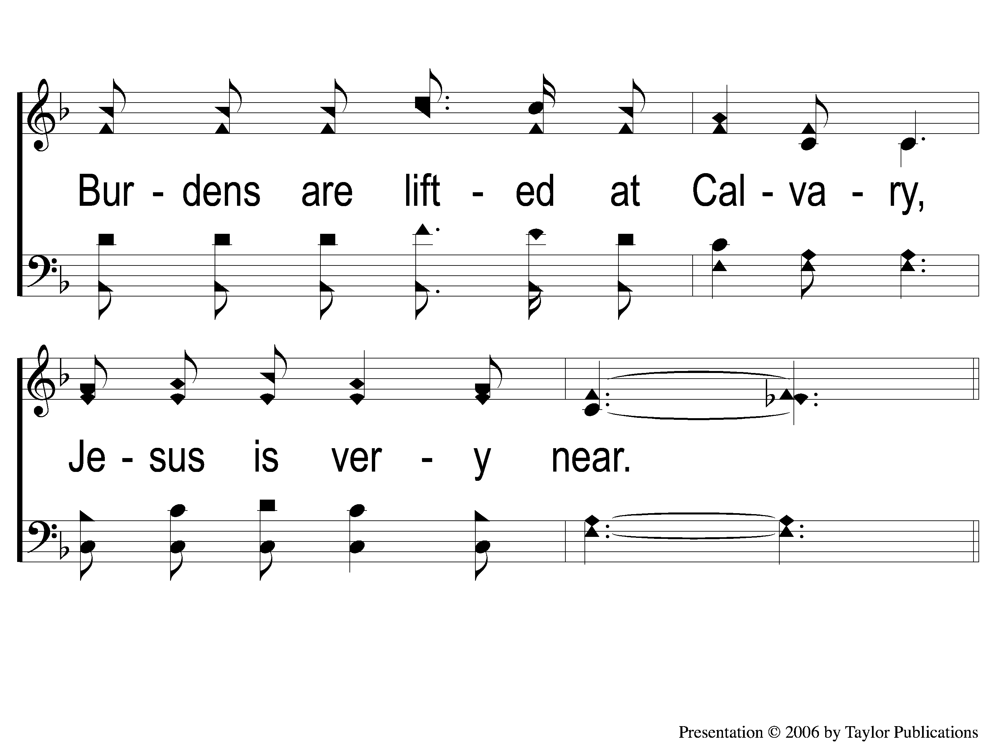
1-2 Burdens Are Lifted At Calvary
Burdens Are Lifted At Calvary
50

Slide 3
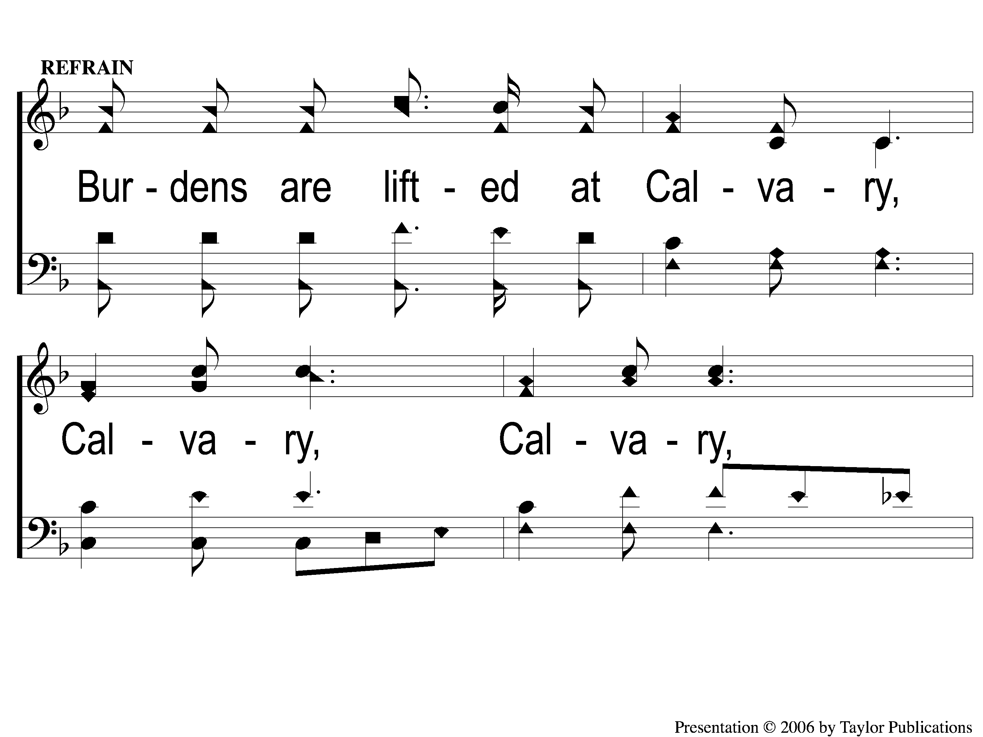
C-1 Burdens Are Lifted At Calvary
Burdens Are Lifted At Calvary
50

Slide 4
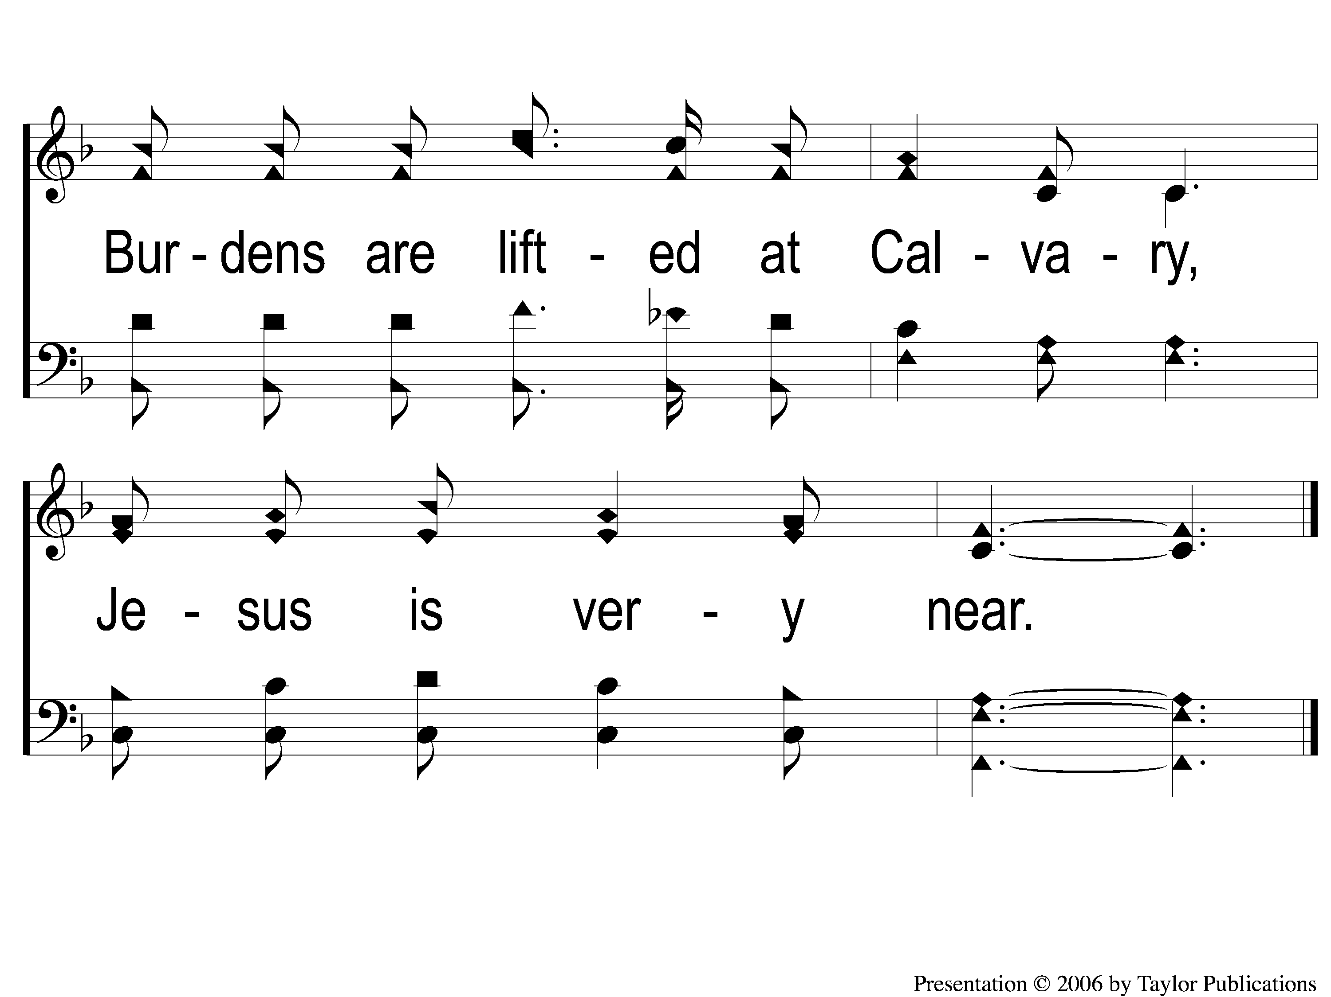
C-2 Burdens Are Lifted At Calvary
Burdens Are Lifted At Calvary
50

Slide 5
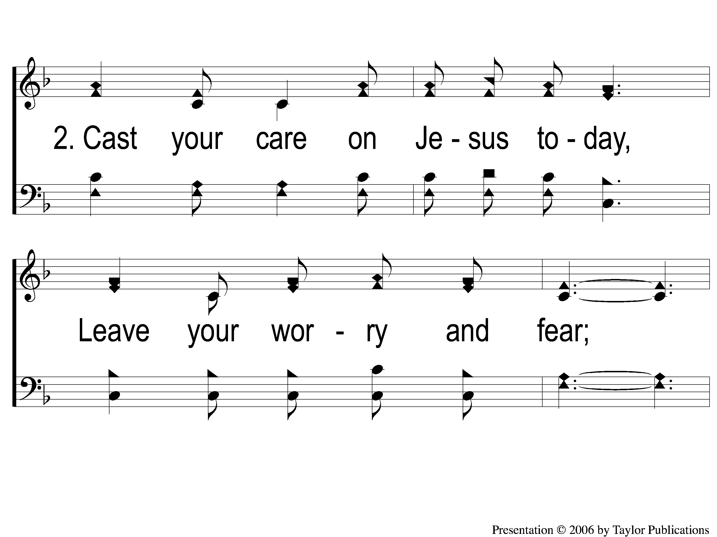
2-1 Burdens Are Lifted At Calvary
Burdens Are Lifted At Calvary
50

Slide 6
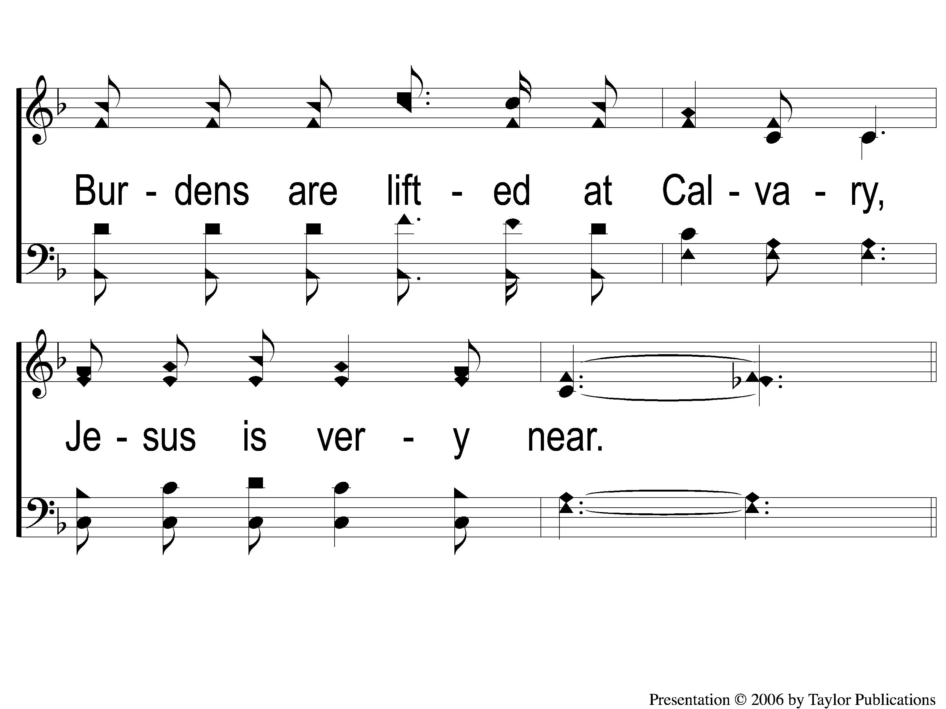
2-2 Burdens Are Lifted At Calvary
Burdens Are Lifted At Calvary
50

Slide 7
C-1 Burdens Are Lifted At Calvary
Burdens Are Lifted At Calvary
50

Slide 8
C-2 Burdens Are Lifted At Calvary
Burdens Are Lifted At Calvary
50

Slide 9
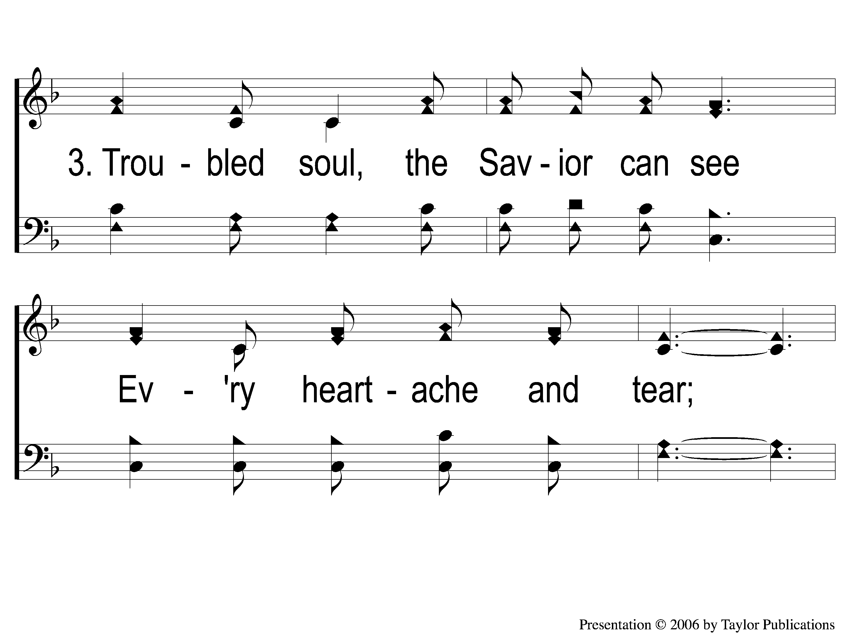
3-1 Burdens Are Lifted At Calvary
Burdens Are Lifted At Calvary
50

Slide 10
3-2 Burdens Are Lifted At Calvary
Burdens Are Lifted At Calvary
50

Slide 11
C-1 Burdens Are Lifted At Calvary
Burdens Are Lifted At Calvary
50

Slide 12
C-2 Burdens Are Lifted At Calvary
Burdens Are Lifted At Calvary
50

